Slide 1
Deep learning
-ANN
-CNN
-RNN

Slide 2
Course Agenda
History of deep learning
Deep learning vs Machine learning
Gpu vs cpu
Tensorflow
Ann(Artificial Neural Network) vs Human Brain
Structure of Ann
How neural network works
Activation functions
Training of neural networks
Handson on linear regression with ANN
Handson on classification with ANN
CNN
How CNN works
Handson on CNN

Slide 3
Today’s Agenda
Deep learning vs Machine learning
Use cases
Gpu vs cpu
Tensorflow
Google colab

Slide 4
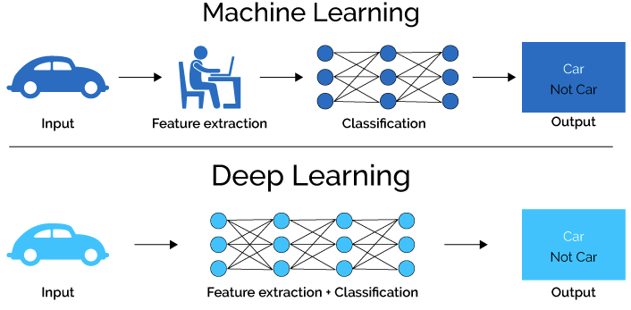

Slide 5
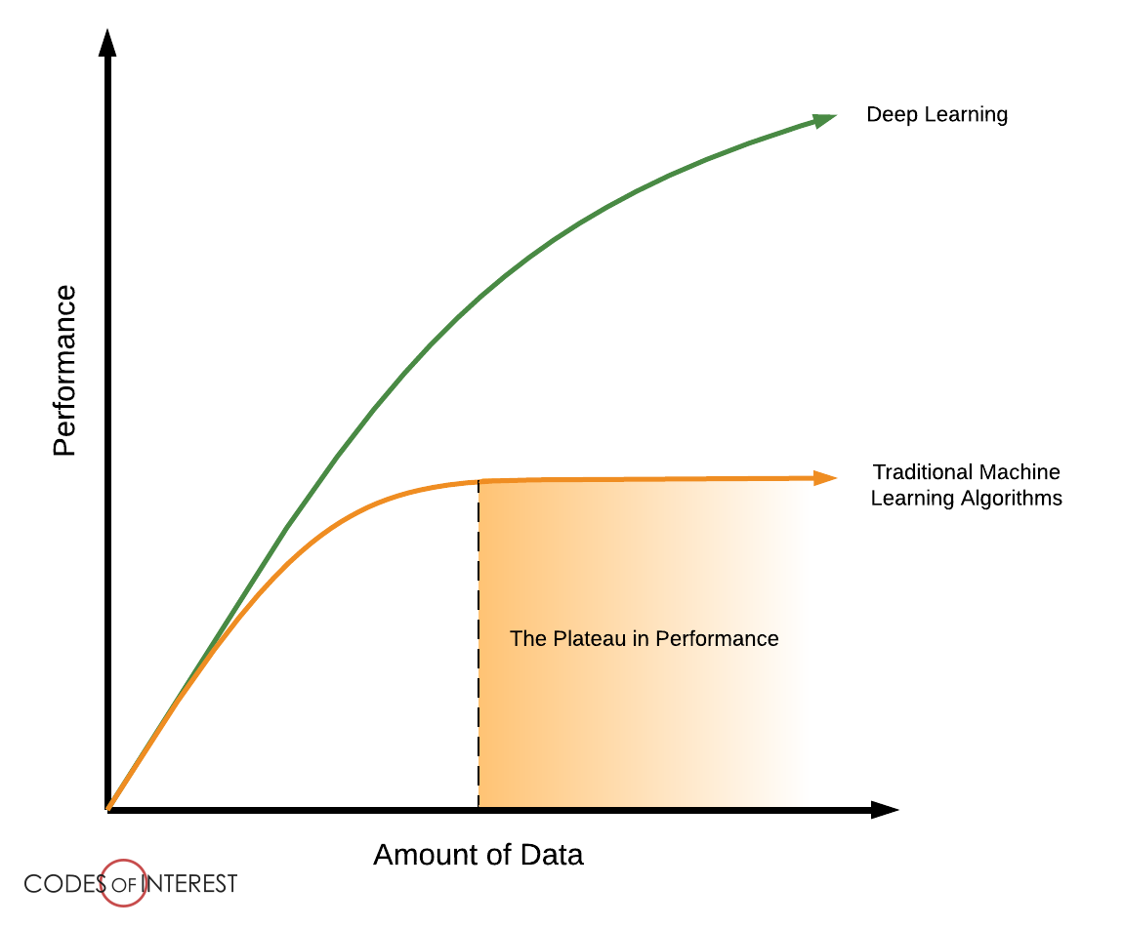

Slide 6
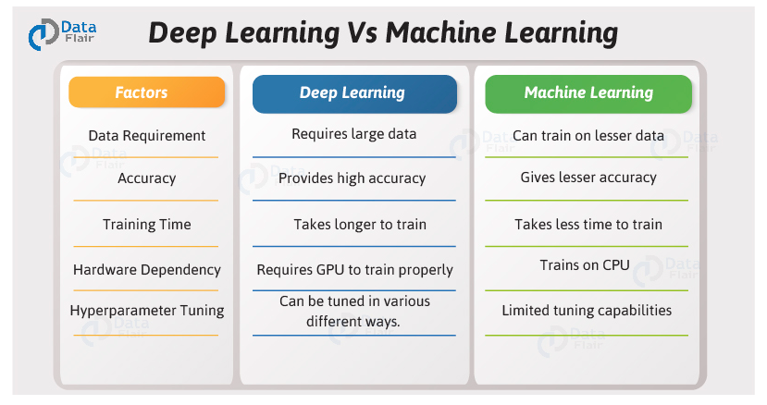

Slide 7
Use cases
Object detection – self driving cars
Image Recogntion and Classification
Speech Recognition – Siri , Alexa
My personal Deep learning projects - https://www.linkedin.com/in/afsankhan/detail/recent-activity/shares/

Slide 8
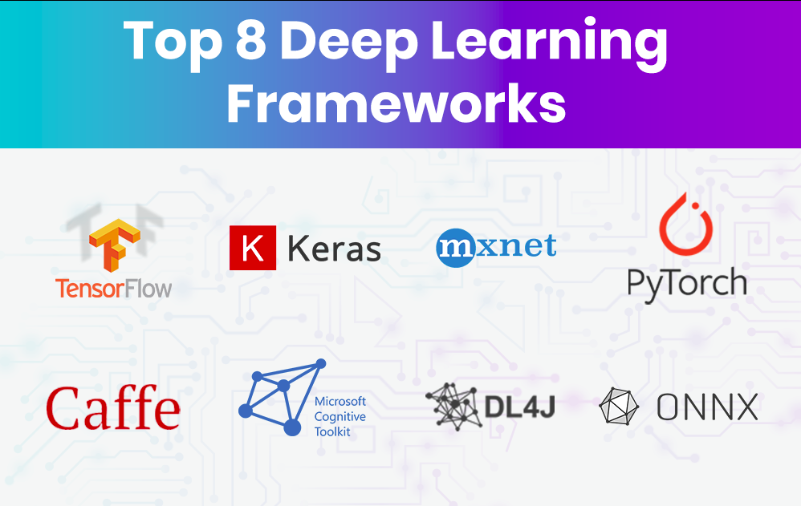

Slide 9
What is TensorFlow?
Tensorflow is an open-source library for Deep Learning and Machine Learning
Developed by the Google Brain team and released in November 2015
Tensorflow = Tensor + Flow = Data + Flow

Slide 10
But What is Tensor?
An n-dimensional array:
- 0-d tensor – scalar(number)
- 1-d tensor – vector
- 2-d tensor – matrix
- and so on

Slide 11
But what is Tensor Flow?
Data Flow Graphs
    - Dataflow is a common programming model for parallel computing
    - TensorFlow uses a dataflow graph to represent your computation

Slide 12
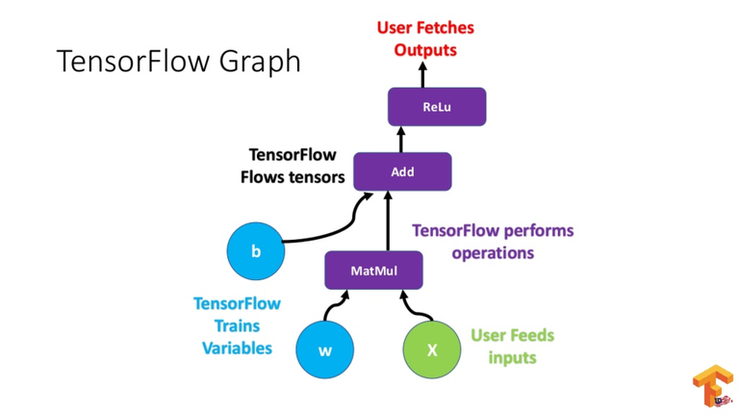

Slide 13
What are the benefits of using graphs?
Parallelism. (it is easy for the system to identify operations that can exceute in parallel)
Distributed excecution (it is possible for tensorflow to partition your program across multiple devices CPUs , GPUs, and TPUs)
Compilation(generate faster code)
Portability(You can build a dataflow graph in Python, store it in a Saved Model, and restore it in a C++ program)

Slide 14

Why Tensorflow ?

Slide 15
Why Tensorflow: Runs Everywhere
Runs on desktop and mobilde devices such as
- Linux
- macOS
- iOS
- Android
- Raspberry pi
- and Windows

Slide 16
Why TensorFlow: Parallel Computation
TensorFlow supports distributed computing

Slide 17
Why TensorFlow: Large Community
One of the most popular open source projects on GitHub
It has a dedicated team of passionate and helpful developers
Growing community contributing to improve it

Slide 18
Why TensorFlow: Flexibility
Python API offers flexibility to create all sorts of computations ( including any neural network architecture we can think of)
Includes highly efficient C++ implementations of many ML opearions

Slide 19
Why TensorFlow: Google products
It powers many of Google’s large-scale services, such as
- Google Cloud Speech
- Google Photos and
- Google Search

Slide 20
Why TensorFlow: Big Companies using Tensorflow
Google
OpenAI
DeepMind
Uber
Ebay
DropBox

Slide 21
GPU vs CPU

Slide 22
Class 2 agenda
Tensorflow 1.x vs Tensorflow 2.x
History
Types of Neural Network
Biological vs Artificial
Structure
Neural Network Working
Activation functions

Slide 23
Tensorflow 1.x vs Tensorflow 2.x

Slide 24
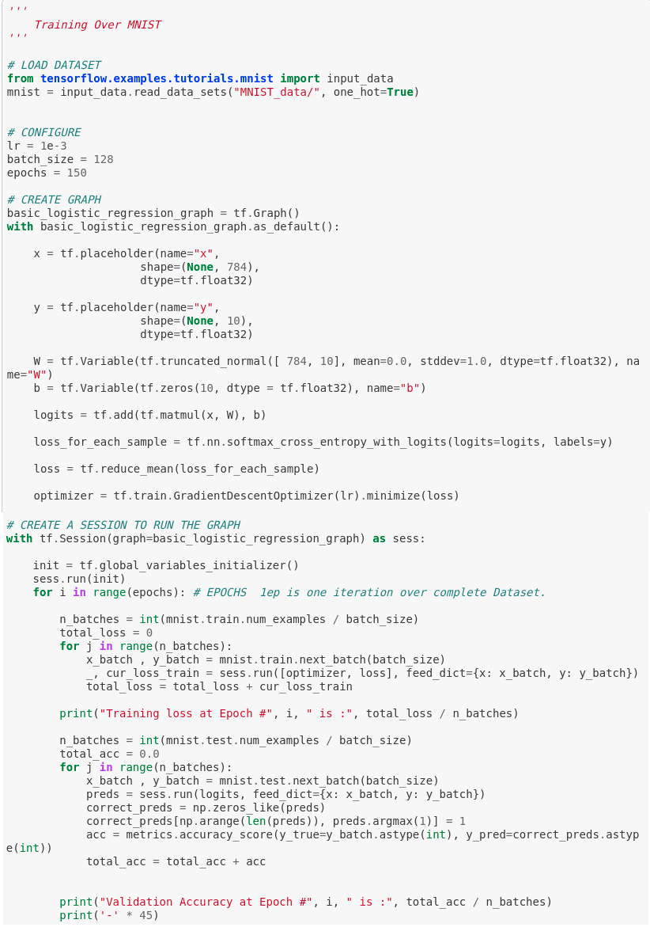
Tensorflow 1.x

Slide 25
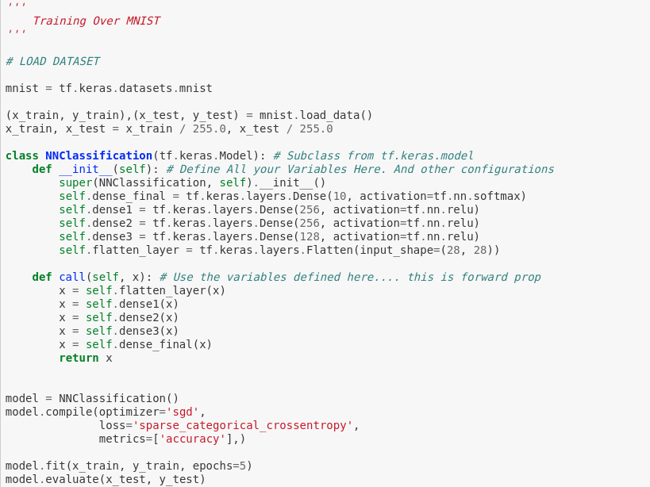
Tensorflow 2.x

Slide 26
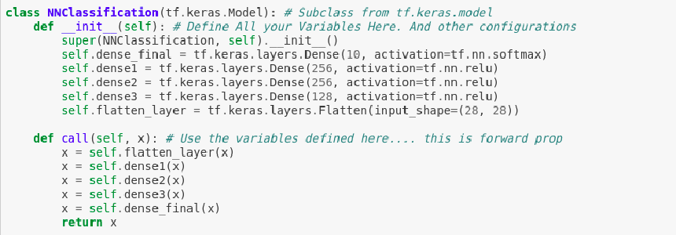
Tensorflow 2.x + keras
model = keras.Sequential([
keras.layers.Reshape(target_shape=(28 * 28,), input_shape=(28, 28)),
keras.layers.Dense(units=256, activation='relu'),
keras.layers.Dense(units=192, activation='relu'),
keras.layers.Dense(units=128, activation='relu'),
keras.layers.Dense(units=10, activation='softmax')
])

Slide 27
Deep learning is the technique that tries to mimic the human brain

Slide 28
Researches from 1950s tried to make a machine that can work like a human brain
This lead to the invention of Neural Network
The first simplest type of neural network was named as Perceptron
This was the basic model but not accurate

Slide 29
In 1980 a Researcher Jeoffrey Hinton invented a concept of Back propogation
With this concept many all the neural network became so efficient that all the companies now a use it in many applications

Slide 30
Types of Neural Network
Artificial Neural Network (ANN)
Convolution Neural Network (CNN)
Recurrent Neural Network (RNN)

Slide 31
Artificial Neural Network

Slide 32
Background
- Neural Network can be:
- Biological models
- Artificial models
We wish to produce artificial system capable of complex calculation similar to the human brain

Slide 33
Describe the transmission of information and some main ideas
The brain is consist of a mass of interconnected neurons
- each neuron is connected to many other neurons
Neurons transmit signals to each other
Whether the signal is sent, depends on the strength of the bond(synapse) between the two neurons

Slide 34
How does the brain work.(1)
Neuron
- It is the cell that performs information processing in the brain
Nervous tissue its consist of neurons, which receive and transmit impluses

Slide 35
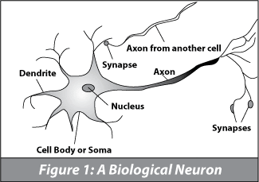
How does Brain work? (2)
Each consist of:
      SOMA, DENDRITES, AXON and SYNAPSE

Slide 36
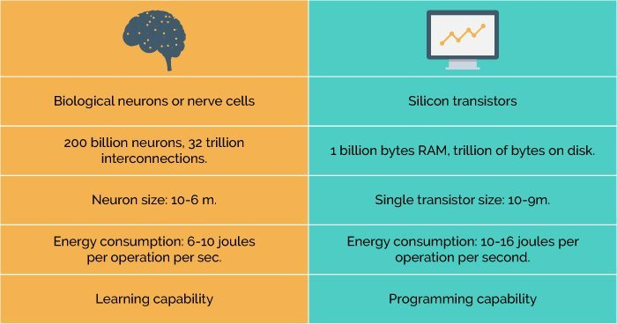
How is brain different from computers

Slide 37
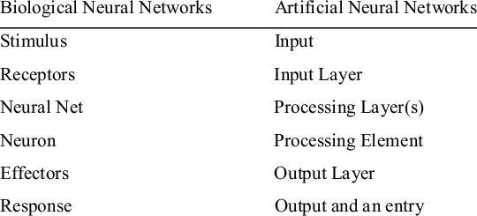
Comparing ANN with BNN

Slide 38
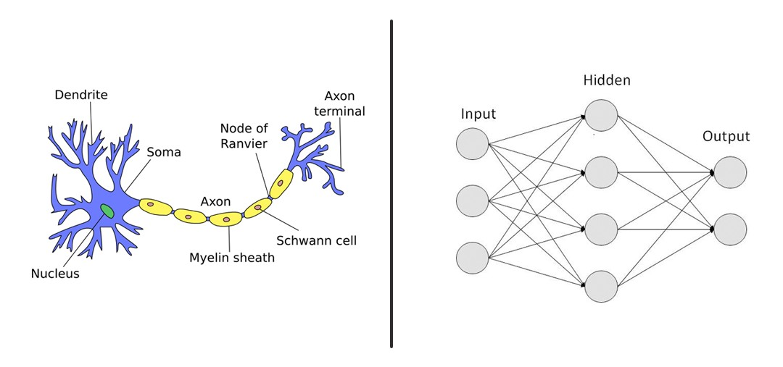

Slide 39
Lets understand the structure

Slide 40
We take the input from eye so lets called it as a input layer
The information is send to brain where processing is done and information is passed through all the neurons on multiple levels so lets called it as it has hidden layer
And then some output is given out in form of some action so lets called it as Output layer

Slide 41
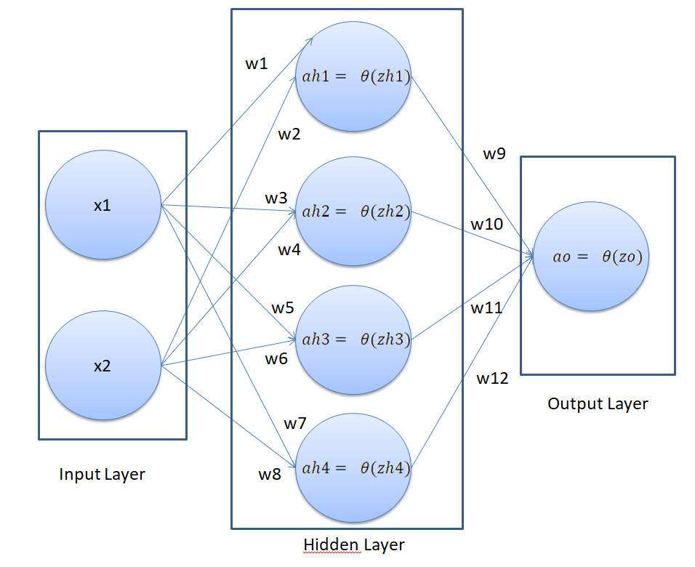
Artificial neural network

Slide 42
How Neural network works?

Slide 43
Todays agenda
Activation function
Back propogation
Handson
Weight intialization technique
Dropout
handson

Slide 44
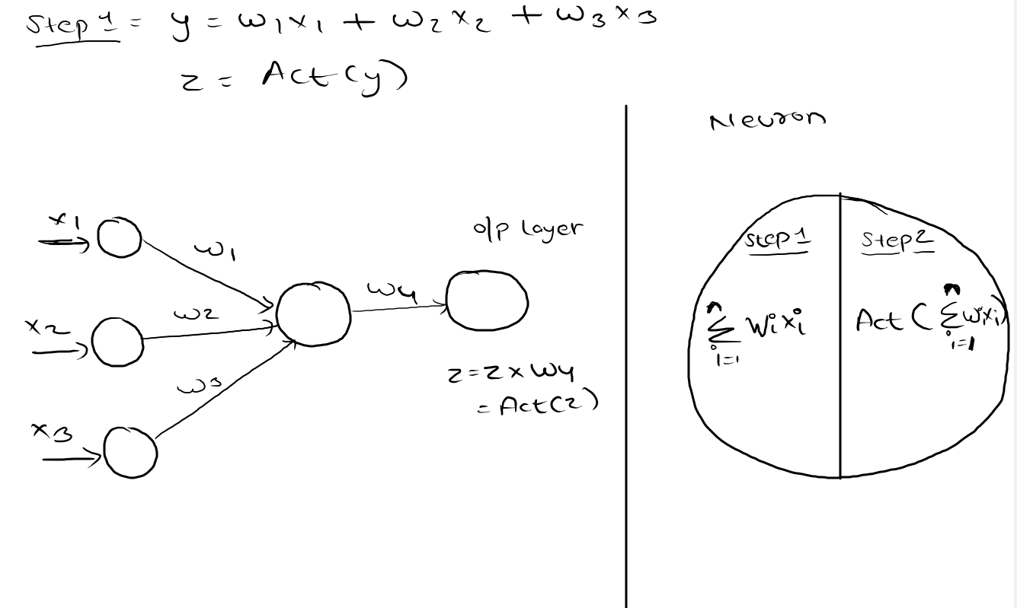

Slide 45
Activation Functions
Sigmoid
Relu

Slide 46

Why Activation functions
So consider a neuron.
the value of Y can be anything ranging from -inf to +inf. The neuron really doesn’t know the bounds of the value.
So how do we decide whether the neuron should fire or not ( why this firing pattern? Because we learnt it from biology that’s the way brain works and brain is a working testimony of an awesome and intelligent system ).

Slide 47
We decided to add “activation functions” for this purpose. To check the Y value produced by a neuron and decide whether outside connections should consider this neuron as “fired” or not. Or rather let’s say — “activated” or not.

Slide 48
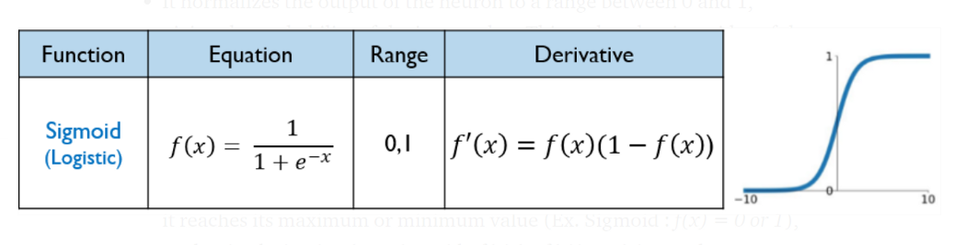
Sigmoid

Slide 49
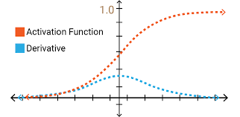

Slide 50
The output of the sigmoid function always ranges between 0 and 1 .
Sigmoid is S-shaped
Derivative /Differential of the sigmoid function (f’(x)) will lies between 0 and 0.25.

Slide 51
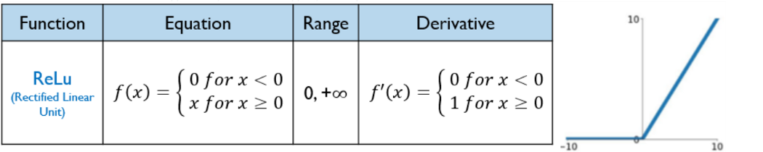
Relu

Slide 52
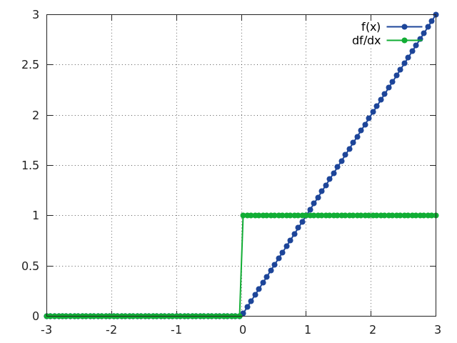

Slide 53
The output of the Linear function always ranges between 0 and + inf .
Derivative /Differential of the Tanh function (f’(x)) will be 1 if f(x) > 0 else 0.

Slide 54
How to train Neural Network with Backpropgation

Slide 55
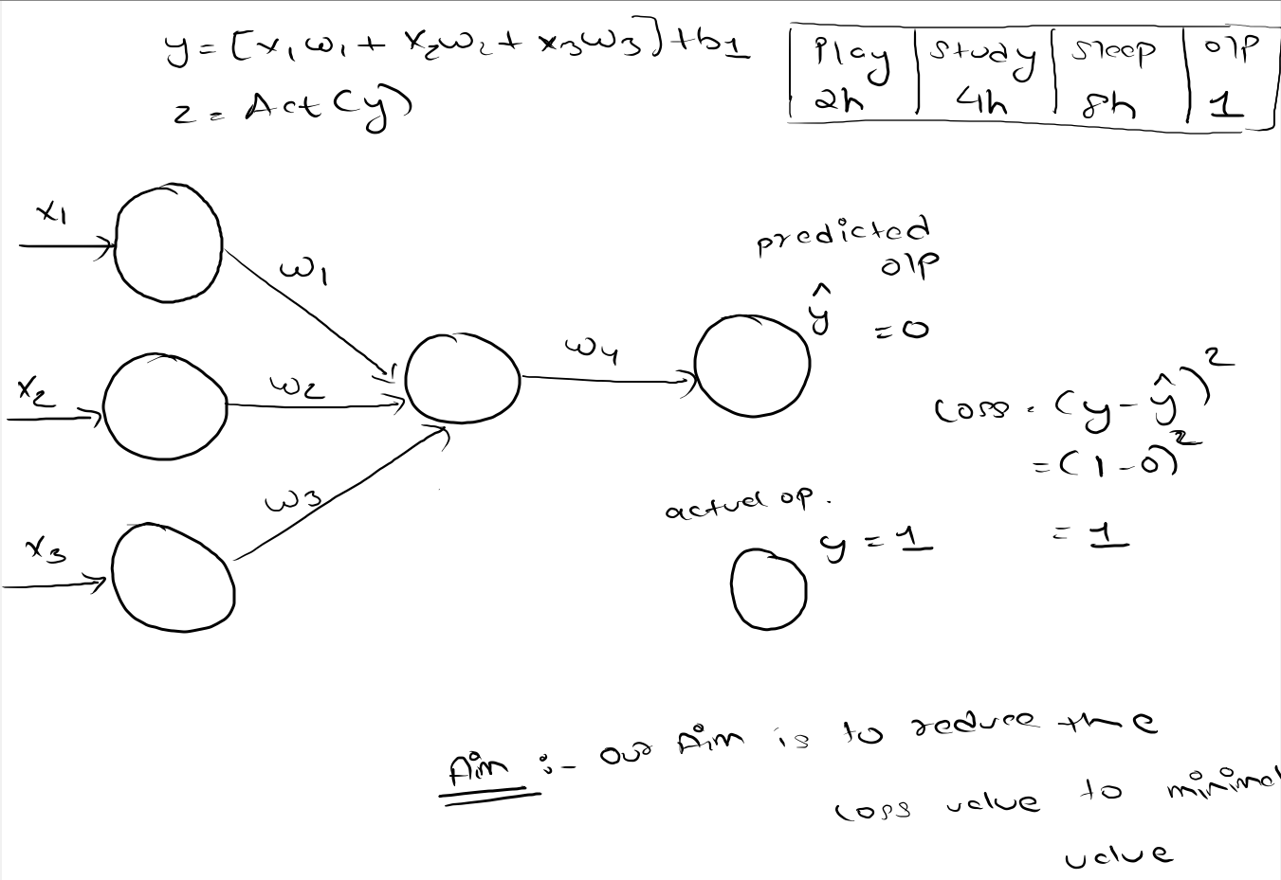

Slide 56
Training takes place in two steps
1 . Forward propogation
- The values x1 , x2, x3 are passed through the neuron to the hidden layers
- then we calculate the y and the output is passed through the output layer
- at the output layer we get some value for y(hat)
- We try to calculate the loss by using the formula (y-y(hat))**2

Slide 57
Back propogation
- after calculating the loss we try to minimize the loss with the help of optimizer
- during Back propogation we try to change the weights(w1,w2,w3,w4) in such a way that are loss decreases by each step

Slide 58
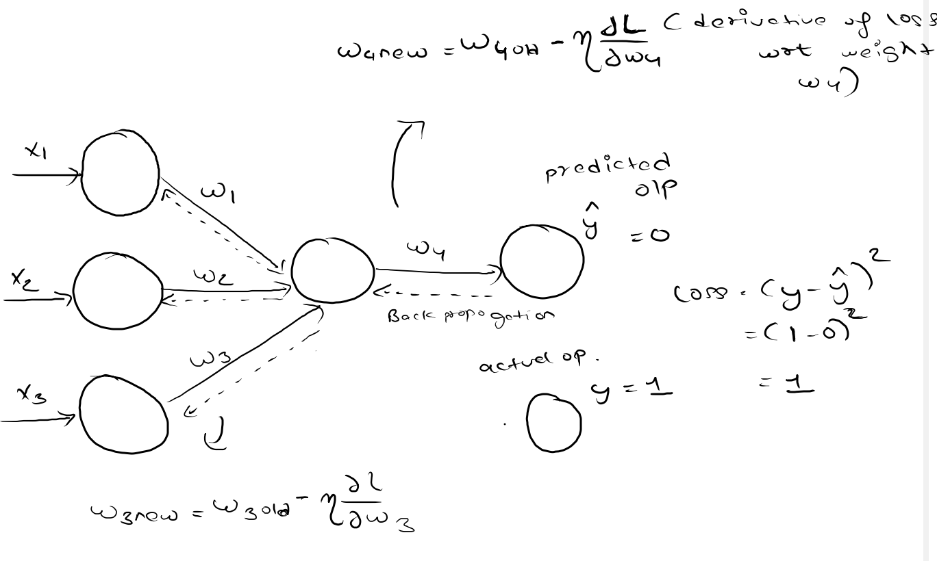

Slide 59
After back propogation again forward propogation takes place
This steps keeps on repeating unless we get the best weight value or the minimum loss

Slide 60
Weight Initialization Techniques

Slide 61
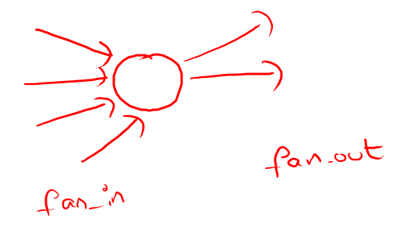

Slide 62
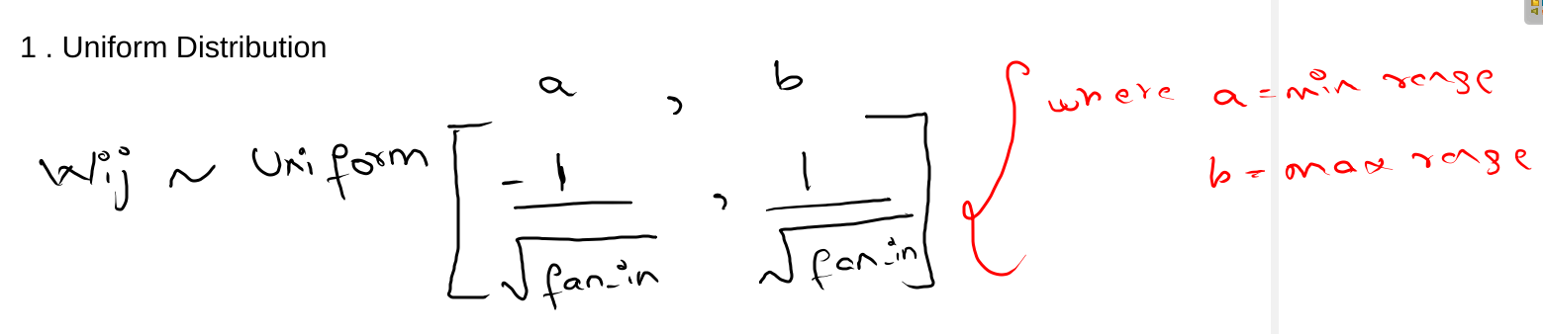

Slide 63
2 . Xavier / Gorat distribution
    - Xavier Normal or Gorat Normal
    - Xavier Uniform or Gorat Uniform

Slide 64
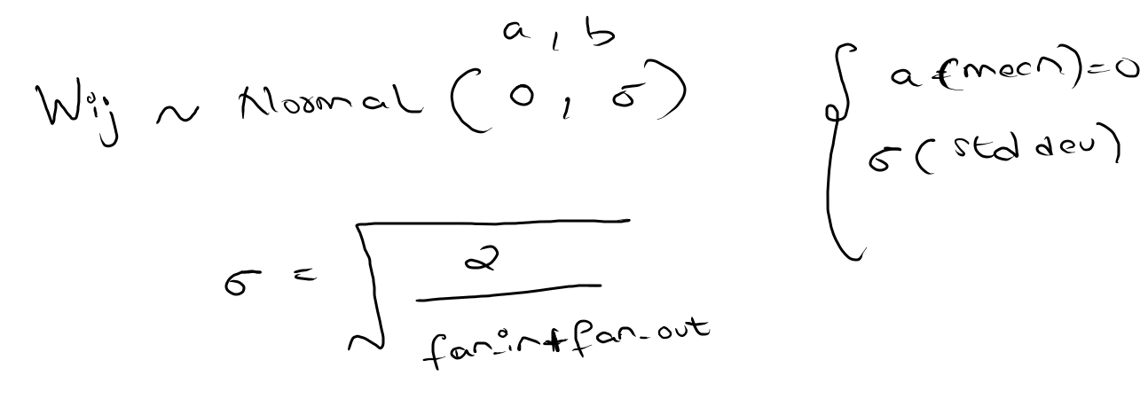
Xavier / Gorat Normal

Slide 65
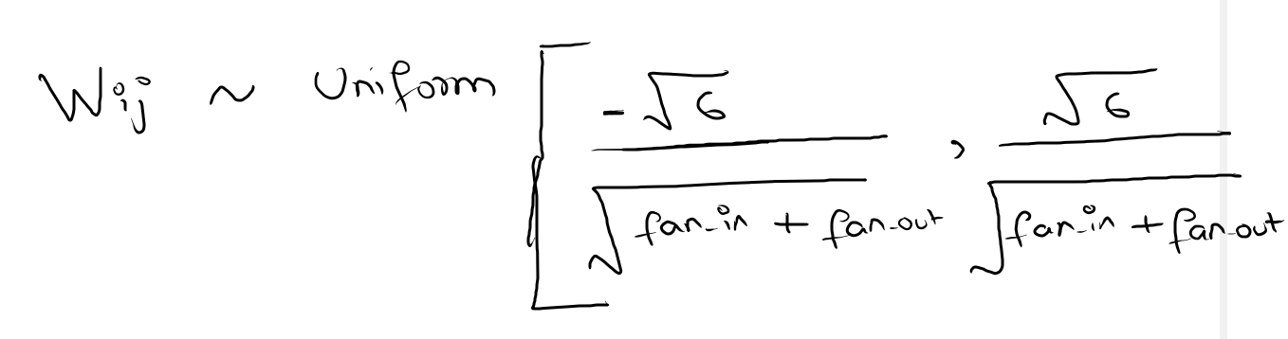
Xavier / Gorat Uniform

Slide 66
He initialization
- he normal
- he uniform

Slide 67
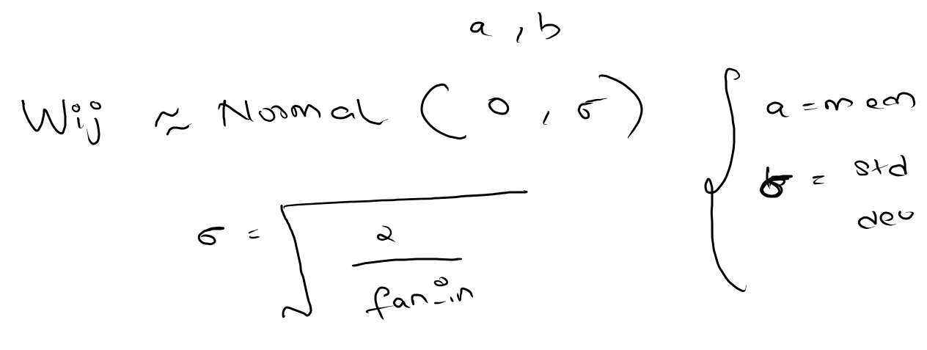
He normal

Slide 68
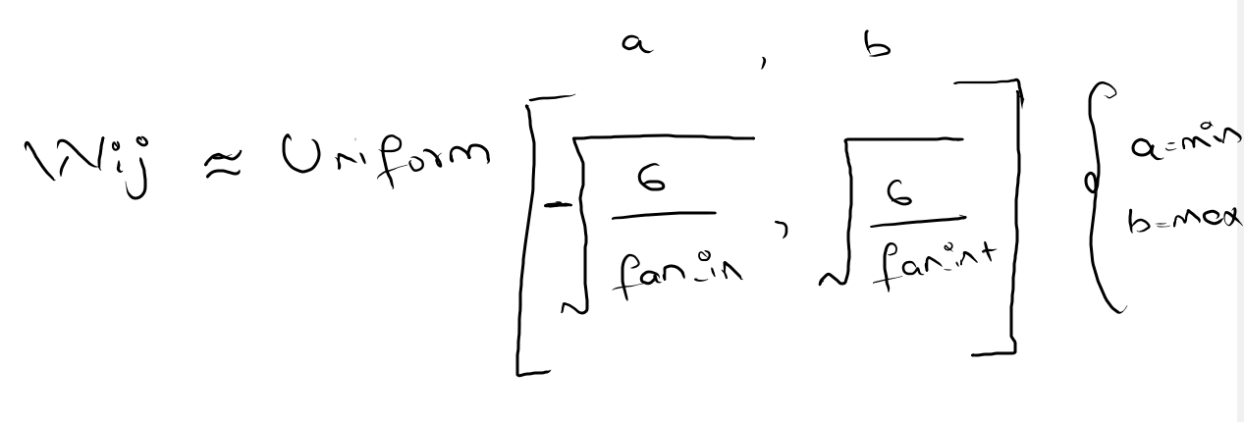
He unifrom

Slide 69
Tips
Xavier / Gorat works good with Sigmoid Activation function
He init works good with relu activation function

Slide 70
Drop-out and Regularization

Slide 71
When we have ANN which is very deep then we will have many weights and many bias parameters
So our ANN model tends to overfit the dataset problem or use-cases
So we have to find out a way to how to fix a overfitting Problem
note – Underfitting will never happen in multilevel neural network

Slide 72
Problem:
When a fully-connected layer has a large number of neurons, co-adaption is more likely to happen. Co-adaptation refers to when multiple neurons in a layer extract the same, or very similar, hidden features from the input data. This can happen when the connection weights for two different neurons are nearly identical.

Slide 73
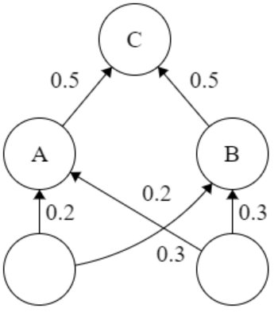

Slide 74
This poses two different problems to our model:
Wastage of machine’s resources when computing the same output.
If many neurons are extracting the same features, it adds more significance to those features for our model. This leads to overfitting if the duplicate extracted features are specific to only the training set.

Slide 75
Convolution Neural Network

Slide 76
Convolutional Neural Network(CNN or ConvNet)is a class of deep neural networks which is mostly used to do image recognition, image classification, object detection, etc.
Google uses it for photo search, Facebook for their automatic tagging algorithms, Amazon for their product recommendations, and the list goes on and on…

Slide 77
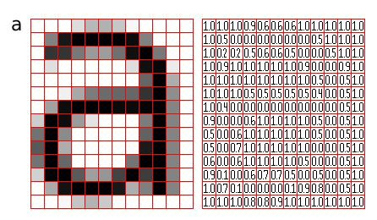
Architecture
Computers can not see things as we do, for computers image is nothing but a matrix.

Slide 78
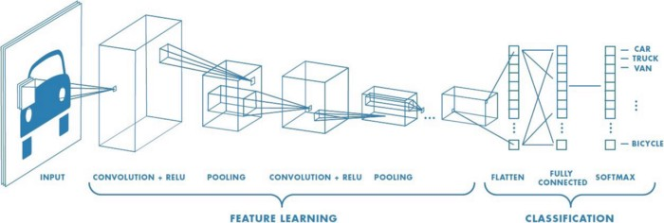
A CNN typically has three layers: a convolutional layer, pooling layer, and fully connected layer.

Slide 79
Lets see basic thing about images first
Grayscale image = 0 to 255
Color images = RGB channels and value is between 0-255

Slide 80
So lets see the first step in convolution neural network

Slide 81
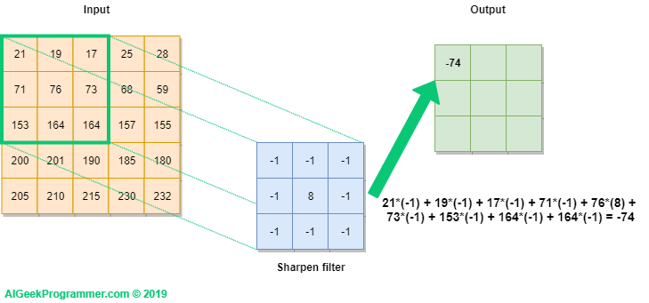
1 Convolution

Slide 82
Important deeplearning links
https://distill.pub/2017/feature-visualization/
https://playground.tensorflow.org/
https://transcranial.github.io/keras-js/#/
Dataset link
Fire dataset - https://www.kaggle.com/atulyakumar98/test-dataset
Face mask dataset - https://www.kaggle.com/omkargurav/face-mask-dataset
Emotion classification - https://www.kaggle.com/msambare/fer2013
Open cv - https://www.geeksforgeeks.org/python-opencv-capture-video-from-camera/
Reading part
Open cv – for realtime prediction
Transfer learning
Object detection

